Slide 1
Centiment
Aarthi Shunmugam

Slide 2
Key Focus
Various Data Sources
Centiment
Centiment Business Goals and the Data Sources
Data Sources & its place in Data Science process
Acquisition of Data Source and Cost Estimate

Slide 3
Know your Customer
Understanding your customer better isn’t as complex as you might think, but it does require a thoughtful analysis of where and how you can collect meaningful data. By better defining which aspects of their behavior or profiles are most significant to your business, you can start to measure and analyze better ways to engage them and ultimately sell more.

Slide 4
Data Sources
Customer’s Real time Behaviour
Demographic Information
Social Media
Customer Service records/Surveys

Slide 5
Customer Real time Behaviour
Analyze how long visitors are spending on your website
Where they are spending the most time?
What links they are clicking?
What triggers them to share your content on Social media?
What are they Uploading and Downloading? and at what times?

Slide 6





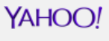
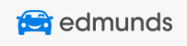


Consumer Real Time Behaviour

Slide 7
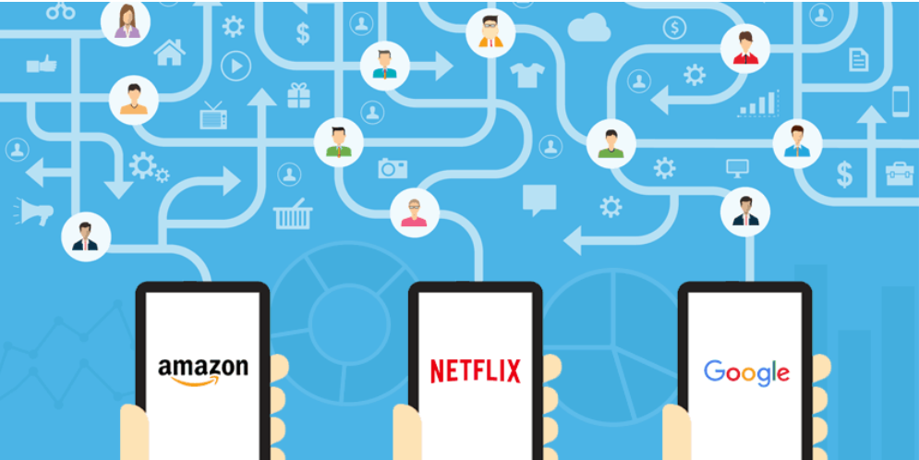
Customer Real time Behaviour

Slide 8
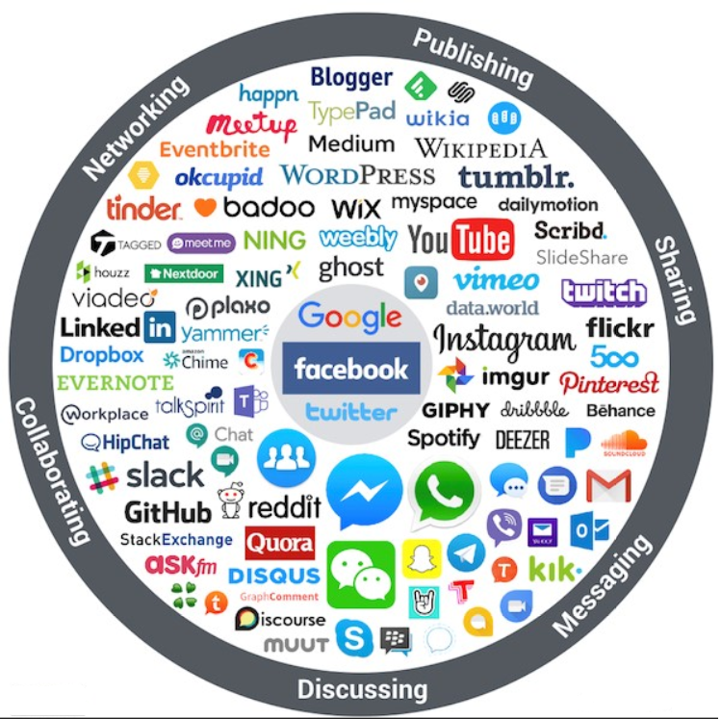
Social Media

Slide 9
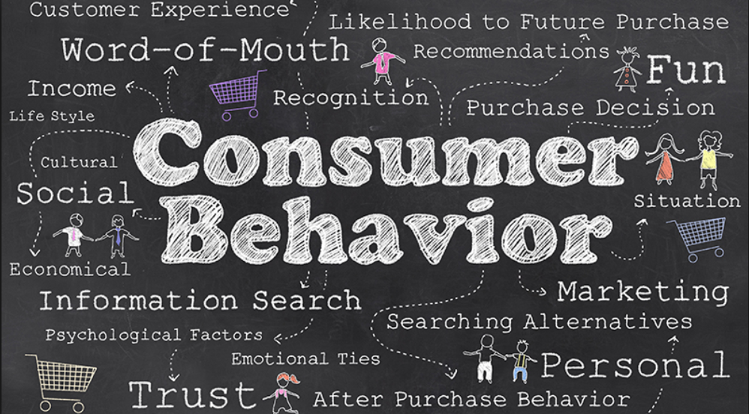
Consumer Behaviour

Slide 10




Demographic Information

Slide 11






Customer Service Record/Surveys

Slide 12
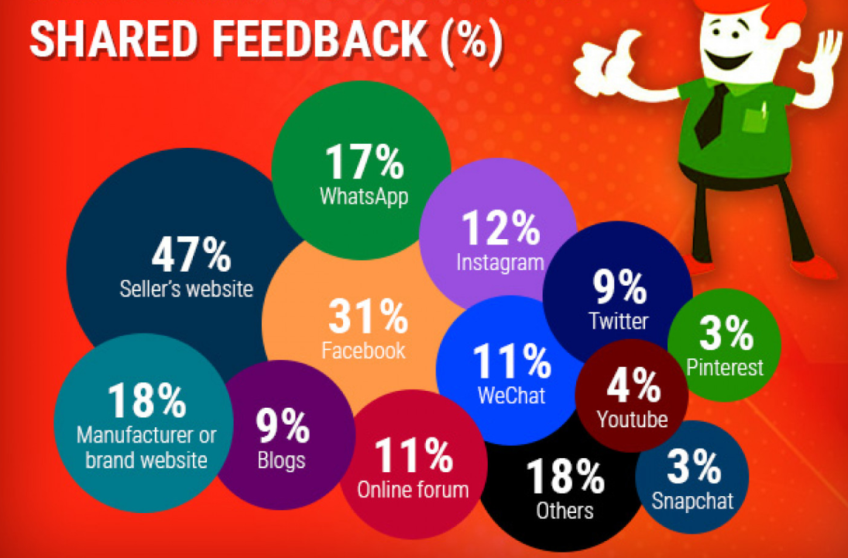
Customer Service Record/Surveys

Slide 13
Centiment Business Goals
Trend Identification
Brand Purpose perception & Positioning
Location based market Insights
Persona Creation

Slide 14








Centiment Business Goals
Trend Identification
Identifying Market Trends from reader’s perspective
Discovering Market Trends on Social Media
Identifying Market Trends with Tools
Identifying Market Trends with Social Intelligence

Slide 15
Centiment Business Goals
Demographic Information
Location Based market Insights

Slide 16

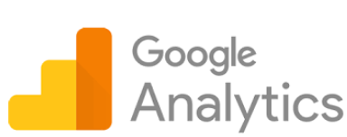
Centiment Business Goals
Persona Creation
Customer Real-Time Behavior
Analyze how long visitors are spending on your website
Where they are spending the most time?
What links they are clicking?
What triggers them to share your content on Social media?
What are they Uploading and Downloading? and at what times?

Slide 17
How Data Source fits in Data Science Process
Web Scraping
Using requests to retrieve the html of a webpage.
Using BeautifulSoup to parse a webpage and extract data from the HTML.
Example:
Get the rating of a particular restaurant based on the reviews from Yelp website
URL:
https://www.yelp.com/search?find_desc=Restaurants&find_loc=New+York%2C+NY&ns=1
Output File Contains the following data:
Name of the Restaurant Open Timing Rating
Amlie 11:30 am - 11:30 pm 4.5 star rating

Slide 18
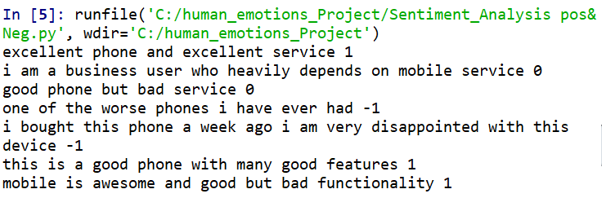
Sentiment Analysis
Sentiment
A thought, view, or attitude, especially one based mainly on emotion instead of reason
Reads a list of reviews and decide if each review is positive or negative based on the occurrences of positive and negative words.
Using Lexicons – Unsupervised Method:

Slide 19
Sentiment Analysis
Which features to use?
Words (unigrams)
Phrases/n-grams
Sentences
How to interpret features for sentiment detection?
Bag of words (IR)
Annotated lexicons (WordNet, SentiWordNet)
Syntactic patterns
Paragraph structure
Naive Bayes Algorithm can be used in Machine Learning to classify textual data (Ex : Reviews) and calculate the accuracy based on the training and testing dataset

Slide 20
Why do we do Sentiment Analysis
Consumer information
Product reviews
Marketing
Consumer attitudes
Trends
Politics
Politicians want to know voters’ views
Voters want to know politician's’ stances and who else supports them
Social
Find like-minded individuals or communities

Slide 21
Data Analysis

Slide 22
Thank You!

